Slide 1


Database Systems
Chapter 07: More SQL: Complex Queries, Views, and Schema Modification
Bushra
bushra@nu.edu.pk

Slide 2
AGENDA
More Complex SQL Retrieval Queries
Views (Virtual Tables) in SQL
Schema Change Statements in SQL

Slide 3
Self Join
A self join is a regular join, but the table is joined with itself.
Syntax
SELECT column_name(s)
FROM table1 T1, table1 T2
WHERE condition;

Slide 4
Self Join Example
Employee: Retrieve the employee_id and their supervisor_name
id | name | s_id
123 | abc | 456
456 | cde | 789
789 | fgh | 123

Slide 5
Self Join Example
Select e1.id as employee_id, e1.s_id as supersor_id, e2.name as supervisor_name
from employee e1, employee e2
Where e1.s_id=e2.id
name | id | s_id
abc | 123 | 456
cde | 456 | 789
fgh | 789 | 123
name | id | s_id
abc | 123 | 456
cde | 456 | 789
fgh | 789 | 123
Notes:
If we take take cross product now of these tables we will have
Id sid id name sid
123 456 123 abc 456
456 cde 789
789 fgh 123
456 789 123 abc 456
456 cde 789
789 fgh 123
789 123 123 abc 456
456 cde 789
789 fgh 123

Slide 6
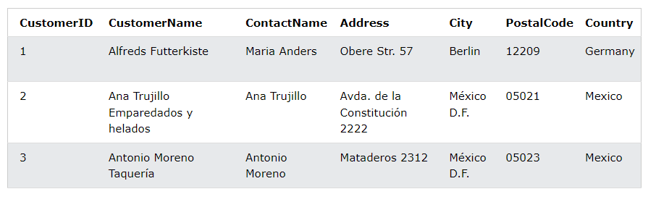
Query
Retrieve customers that are from the same city

Slide 7
Query
Retrieve customers that are from the same city
SELECT A.CustomerName AS CustomerName1, B.CustomerName AS CustomerName2, A.City
FROM Customers A, Customers B
WHERE A.CustomerID <> B.CustomerID
AND A.City = B.City;

Slide 8
Exercise

Slide 9
Query
Retrieve the id of students who studies more than one course
STUDY(S_ID, C_ID)
Sample data for STUDY
SID | CID
S1 | C1
S2 | C2
S1 | C2
Notes:
SELECT S1.S_ID
FROM STUDY S1, STUDY B2
WHERE S1.S_ID=S2.S_ID
AND S1.C_ID <> S2.C_ID

Slide 10
More Complex SQL Retrieval Queries

Slide 11
Three-Valued Logic
SQL uses a three-valued logic with values TRUE, FALSE, and NULL(unknown) instead of the standard two-valued (Boolean) logic with values TRUE or FALSE.
When a record with NULL in one of its attributes is involved in a comparison operation, the result is considered to be UNKNOWN (it may be TRUE or it may be FALSE).

Slide 12
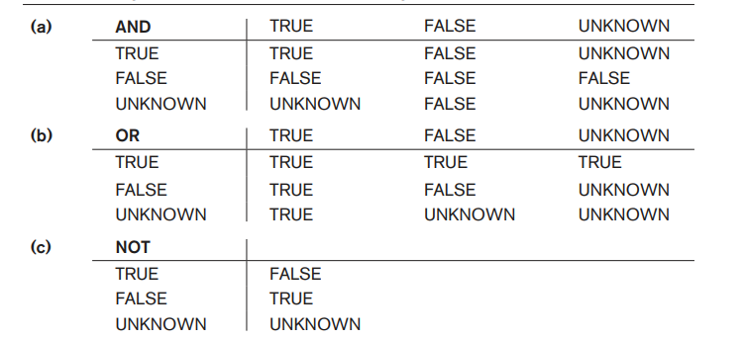
Three-Valued Logic
Logical Connectives in Three-Valued Logic

Slide 13
IS NULL and IS NOT NULL
SQL allows queries that check whether an attribute value is NULL. Rather than using = or <> to compare an attribute value to NULL, SQL uses the comparison operators IS or IS NOT.
This is because SQL considers each NULL value as being distinct from every other NULL value, so equality comparison is not appropriate.
It follows that when a join condition is specified, tuples with NULL values for the join attributes are not included in the result
Notes:
SQL has various rules for dealing with NULL values.
NULL is used to represent a missing value, but that it usually has one of three different interpretations—value unknown (value exists but is not known, or it is not known whether or not the value exists), value not available (value exists but is purposely withheld), or value not applicable (the attribute does not apply to this tuple or is undefined for this tuple).

Slide 14
Query
. Retrieve the names of all employees who do not have supervisors.
SELECT Fname, Lname
FROM EMPLOYEE
WHERE Super_ssn IS NULL;
Notes:
SQL has various rules for dealing with NULL values.

Slide 15
Aggregate Functions in SQL

Slide 16
Aggregate Functions in SQL
used to summarize information from multiple tuples into a single-tuple summary.
built-in aggregate functions exist: COUNT, SUM, MAX, MIN, and AVG.
The COUNT function returns the number of tuples or values as specified in a query.
The functions SUM, MAX, MIN, and AVG can be applied to a set or multiset of numeric values and return, respectively, the sum, maximum value, minimum value, and average (mean) of those values
Example: Find the sum of the salaries of all employees, the maximum salary, the minimum salary, and the average salary
SELECT SUM (Salary), MAX (Salary), MIN (Salary), AVG (Salary) FROM EMPLOYEE;
Notes:
These functions can be used in the SELECT clause or in a HAVING clause

Slide 17
What is the difference between following queries
What is the difference between following queries
SELECT COUNT (Salary) FROM EMPLOYEE;
Vs
SELECT COUNT (DISTINCT Salary) FROM EMPLOYEE;
Notes:
If we write COUNT(SALARY) instead of COUNT(DISTINCT SALARY), then duplicate values will not be eliminated. However, any tuples with NULL for SALARY will not be counted
In general, NULL values are discarded when aggregate functions are applied to a particular column (attribute); the only exception is for COUNT(*) because tuples instead of values are counted

Slide 18
Grouping: The GROUP BY
Grouping is used to create subgroups of tuples before summarization
The GROUP BY clause specifies the grouping attributes
Example:
For each department, retrieve the department number, the number of employees in the department, and their average salary.
SELECT Dno, COUNT (*), AVG (Salary) FROM EMPLOYEE GROUP BY Dno;

Slide 19
Grouping: The GROUP BY
If NULLs exist in the grouping attribute, then a separate group is created for all tuples with a NULL value in the grouping attribute.
For example, if the EMPLOYEE table had some tuples that had NULL for the grouping attribute Dno, there would be a separate group for those tuples in the result

Slide 20
HAVING Clauses
Sometimes we want to retrieve the values of these functions only for groups that satisfy certain conditions.
HAVING Clause provides a condition on the summary information regarding the group of tuples associated with each value of the grouping attributes.
Only the groups that satisfy the condition are retrieved in the result of the query.

Slide 21
Grouping: The GROUP BY
Example:
For each department, retrieve the department number, the number of employees in the department, and their average salary having number of employees greater than 2.
SELECT Dno, COUNT (*), AVG (Salary) FROM EMPLOYEE
GROUP BY Dno
HAVING COUNT(*) > 2;

Slide 22
Exercise

Slide 23
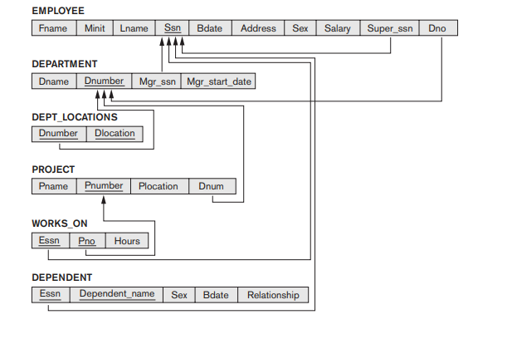
Query
Find the sum of the salaries of all employees of the ‘Research’ department, as well as the maximum salary, the minimum salary, and the average salary in this department.
Notes:
SELECT SUM (Salary), MAX (Salary), MIN (Salary), AVG (Salary)
FROM EMPLOYEE JOIN DEPARTMENT ON Dno = Dnumberb
WHERE Dname = ‘Research’;

Slide 24
Nested Queries

Slide 25
NESTED QUERIES
Some queries require that existing values in the database be fetched and then used in a comparison condition.
Such queries can be conveniently formulated by using nested queries, which are complete select-from-where blocks within another SQL query.
A Subquery or Inner query or a Nested query is a query within another SQL query and embedded within the WHERE clause.
That other query is called the outer query.
These nested queries can also appear in the WHERE clause or the FROM clause or the SELECT clause or other SQL clauses as needed
Notes:
It follows that when a join condition is specified, tuples with NULL values for the join attributes are not included in the result (unless it is an OUTER JOIN)

Slide 26
USING JOINS
Q: list the employee names in sales department.
select * from employees e, departments d
where e.department_id =d.department_id and d.department_name='Sales';

Slide 27
USING SUBQUERIES
Q: list the employee names in sales department.
select * from employees
where department_id =(
Select department_id from departments
where department_name='Sales‘
);

